Slide 1
ENEL 419
Hypothesis Testing
(Reading Exercises: Montgomery and Runger – Sections 9.1.1-9.1.3, 9.1.5, 9.2.1 9.3.1)

Slide 2
Definition
A statistical Hypothesis is an assertion or conjecture concerning one or more populations.
Hypotheses tests are procedures that enable us to decide either to reject or to accept claims or assertions about a population.
Hypothesis testing is a systematic way to test claims or ideas about a population.

Slide 3
Learning Outcomes
You will be able to
Define null hypothesis and alternative hypothesis.
Define Type I error and Type II error.
Define level of significance and test statistic.
Distinguish between one-sided and two-sided hypothesis tests.
Identify the steps involved in the binary hypothesis testing procedure.
Determine critical regions for known/unknown mean and known/unknown variance.
Describe the Student distribution.

Slide 4
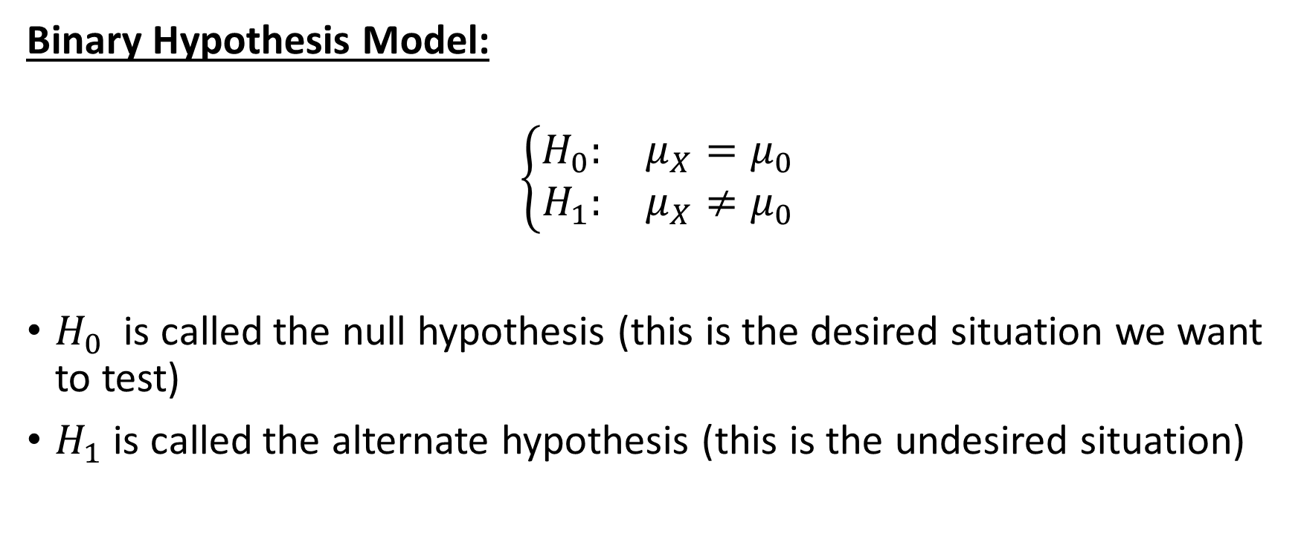
Binary Hypothesis
Binary Hypothesis Model:
$$\left\{\begin{matrix}H_{0}: & μ_{X}=μ_{0} \\ H_{1}: & μ_{X}≠μ_{0}\end{matrix}\right.$$
$H_{0}$ is called the null hypothesis (this is the desired situation we want to test)
$H_{1}$ is called the alternate hypothesis (this is the undesired situation)

Slide 5
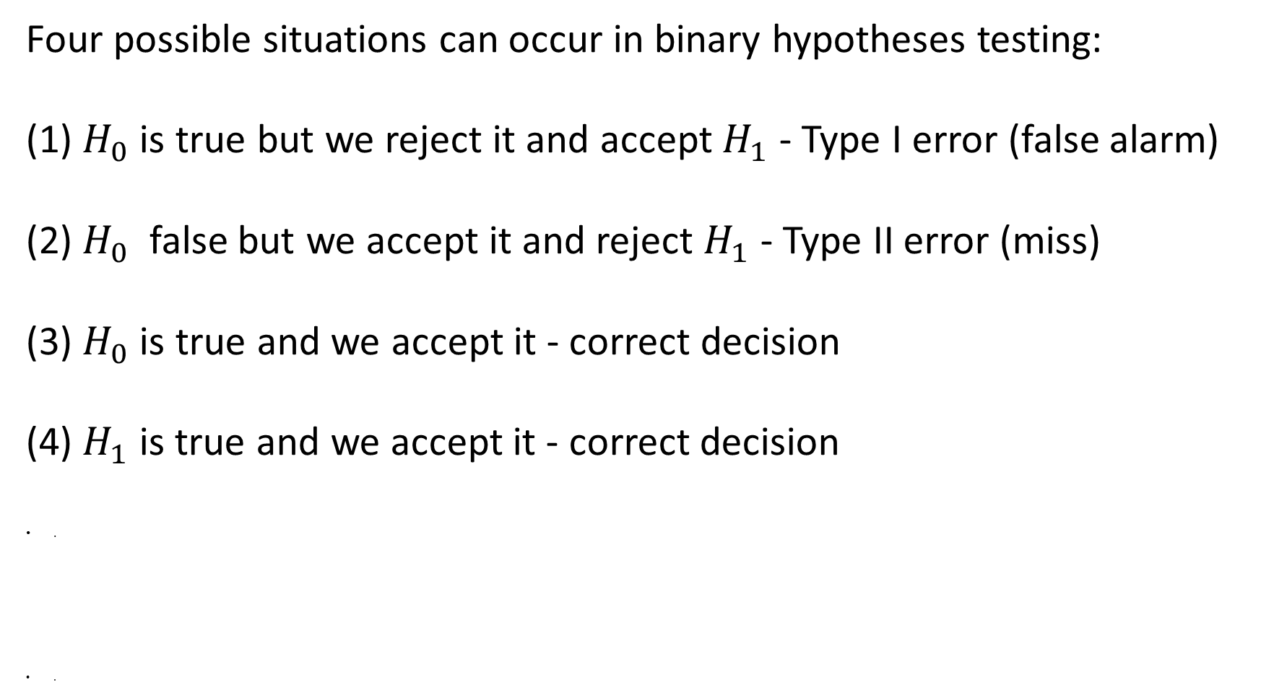
Binary Hypotheses Testing
Four possible situations can occur in binary hypotheses testing:
(1) $H_{0}$is true but we reject it and accept $H_{1}$ - Type I error (false alarm)
(2) $H_{0}$ false but we accept it and reject $H_{1}$ - Type II error (miss)
(3) $H_{0}$is true and we accept it - correct decision
(4) $H_{1}$ is true and we accept it - correct decision
.
.

Slide 6
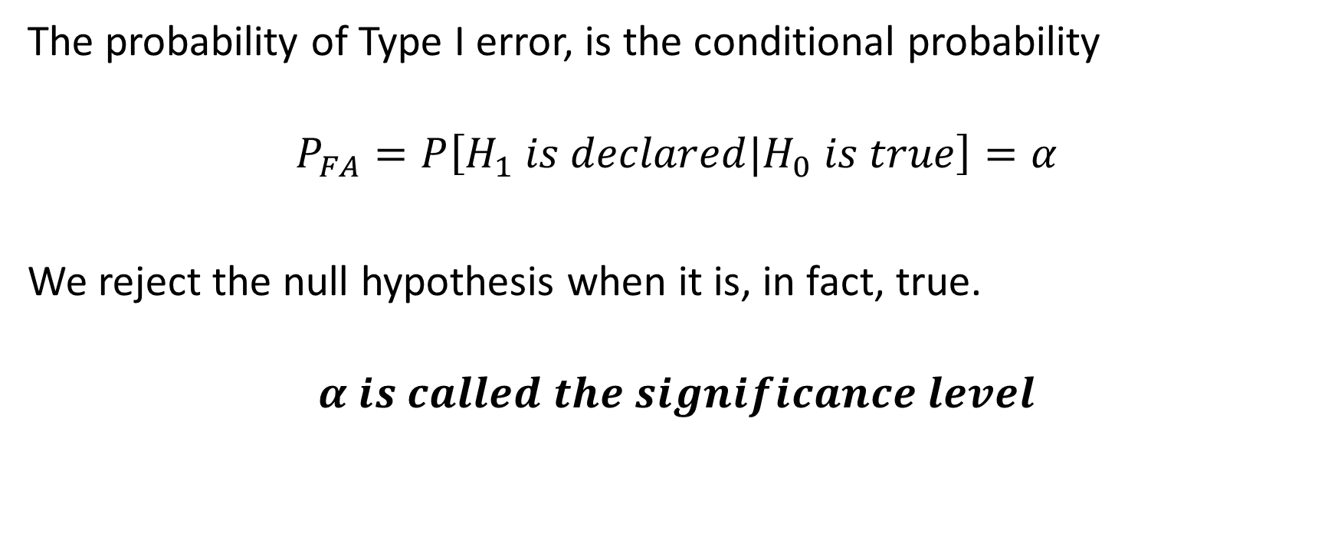
Probability of False Alarm (Type I error)
The probability of Type I error, is the conditional probability
$$P_{FA}=P\left[H_{1} is declared|H_{0} is true\right]=α$$
We reject the null hypothesis when it is, in fact, true.
$$α is called the significance level$$

Slide 7
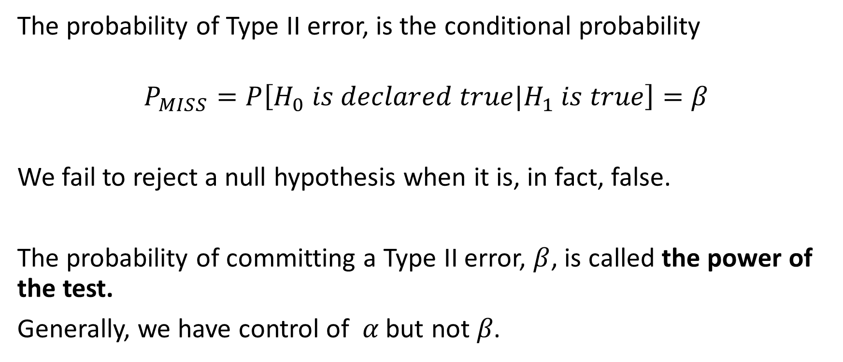
Probability of Miss (Type II Error)
The probability of Type II error, is the conditional probability
$$P_{MISS}=P\left[H_{0} is declared true|H_{1} is true\right]=β$$
We fail to reject a null hypothesis when it is, in fact, false.
The probability of committing a Type II error, $β$, is called the power of the test.
Generally, we have control of 𝛼 but not 𝛽.

Slide 8

Receiver Operating Characteristic (ROC)
A plot of $P_{Miss}$ versus $P_{FA}$ is known as the receiver operating characteristic (ROC).
The ROC shows the trade-off between probability of miss and probability of false alarm.

Slide 9
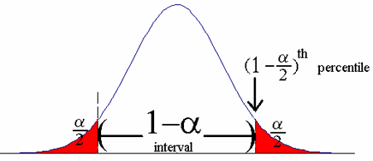

Confidence Level versus Significance Level
Confidence Level $(1−α)$ is a range of results from an experiment that would be expected to contain the true population mean.
We reject the null hypothesis when it is, in fact, true

Slide 10
Two-sided versus One-sided Tests
Two-sided Hypotheses Tests: There are two rejection (or critical) regions – one in the right tail and the other in the left tail of the probability distribution curve.

Slide 11
Two-sided versus One-sided Tests
One-sided Hypotheses Tests: There is only one rejection (or critical) region – either in the right tail or in the left tail of the probability distribution curve.

Slide 12
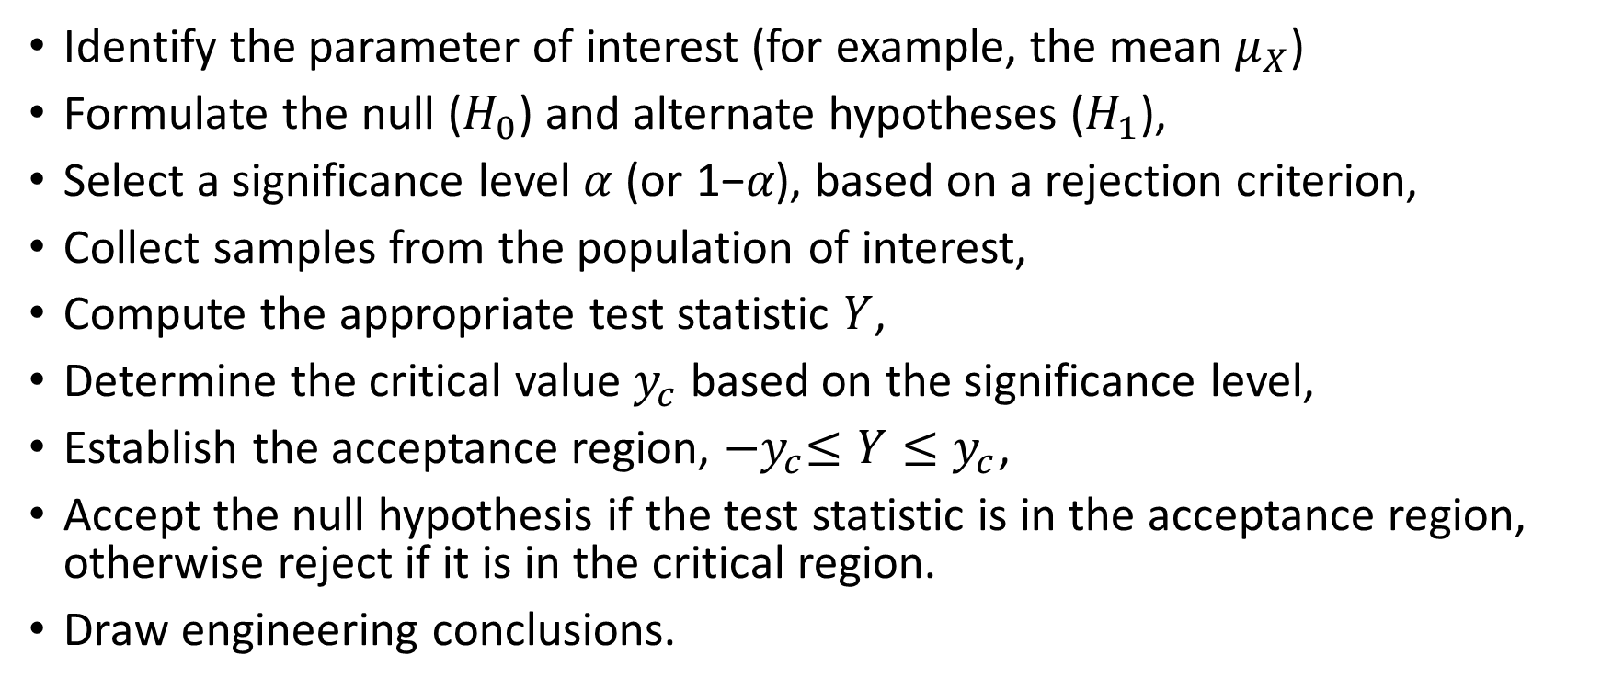
Steps for Binary Hypothesis Testing
Identify the parameter of interest (for example, the mean $μ_{X}$)
Formulate the null ($H_{0}$) and alternate hypotheses ($H_{1}$),
Select a significance level $α$ (or 1−𝛼), based on a rejection criterion,
Collect samples from the population of interest,
Compute the appropriate test statistic $Y$,
Determine the critical value $y_{c}$ based on the significance level,
Establish the acceptance region, ${−y}_{c}≤Y≤y_{c}$,
Accept the null hypothesis if the test statistic is in the acceptance region, otherwise reject if it is in the critical region.
Draw engineering conclusions.

Slide 13
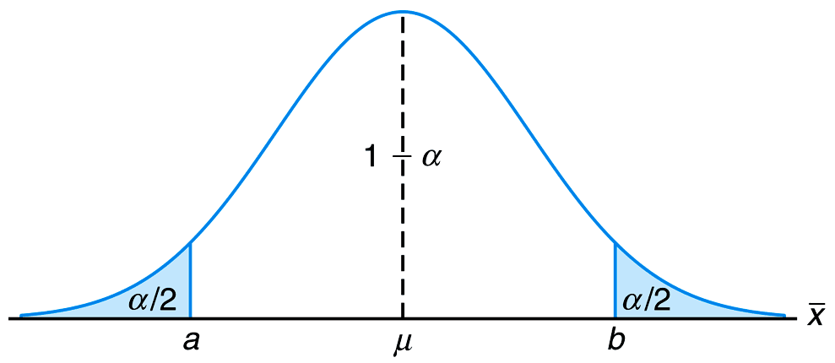

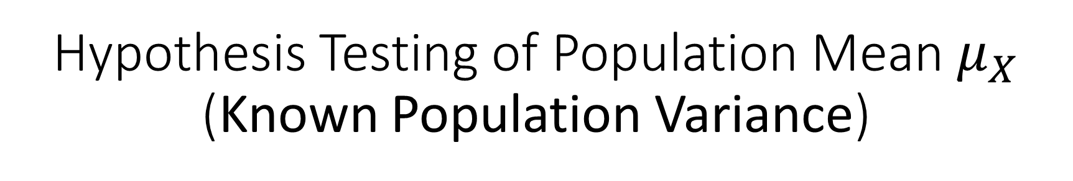
Hypothesis Testing of Population Mean $μ_{X}$ (Known Population Variance)
${Unknown μ_{X} and Known σ}_{X}^{2}$:
We want to test a claim that the mean value of a population is $μ_{X}=μ_{0}.$ This is the null hypothesis.

Slide 14
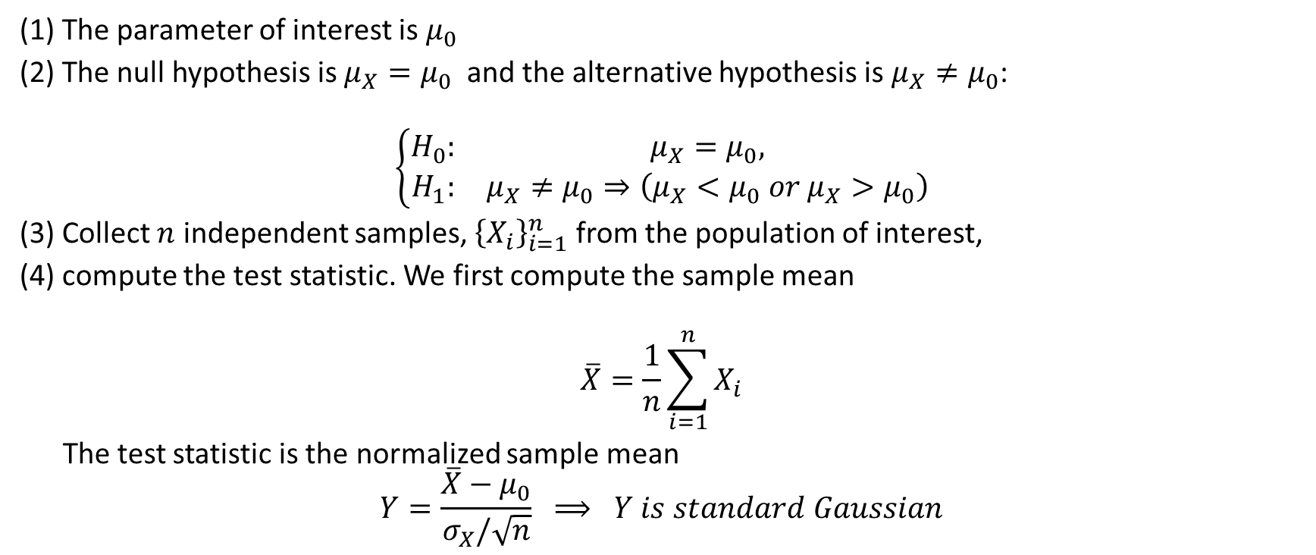
Steps for the Hypothesis Test of Population Mean with Known Variance
(1) The parameter of interest is $μ_{0}$
(2) The null hypothesis is ${μ_{X}=μ}_{0}$ and the alternative hypothesis is $μ_{X}≠μ_{0}$:
$$\left\{\begin{matrix}H_{0}: & μ_{X}=μ_{0}, \\ H_{1}: & μ_{X}≠μ_{0}⇒\left(μ_{X}<μ_{0} or μ_{X}>μ_{0}\right)\end{matrix}\right.$$
(3) Collect $n$ independent samples, ${\left\{X_{i}\right\}}_{i=1}^{n}$ from the population of interest,
(4) compute the test statistic. We first compute the sample mean
$$\overline{X}=\frac{1}{n}\sum_{i=1}^{n}{X_{i}}$$
The test statistic is the normalized sample mean
$$Y=\frac{\overline{X}−μ_{0}}{σ_{X}/\sqrt{n}} ⟹ Y is standard Gaussian$$

Slide 15
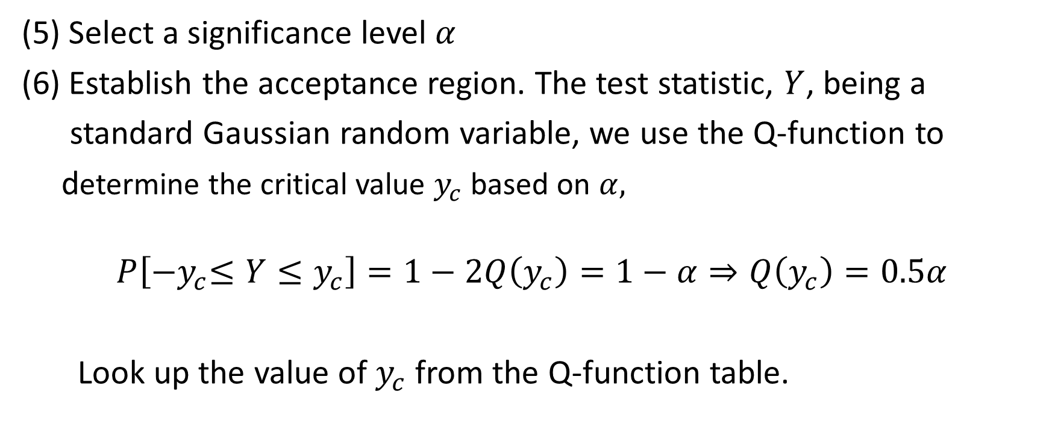
Steps for the Hypothesis Test of Population Mean with Known Variance
(5) Select a significance level $α$
(6) Establish the acceptance region. The test statistic, $Y$, being a
standard Gaussian random variable, we use the Q-function to
determine the critical value $y_{c}$ based on $α,$
$$P\left[{−y}_{c}≤Y≤y_{c}\right]=1−2Q\left(y_{c}\right)=1−α⇒Q\left(y_{c}\right)=0.5α$$
Look up the value of $y_{c}$ from the Q-function table.

Slide 16
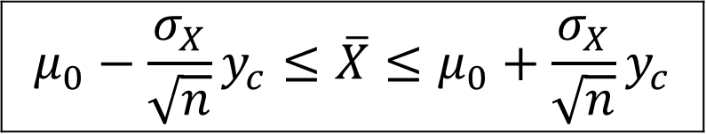
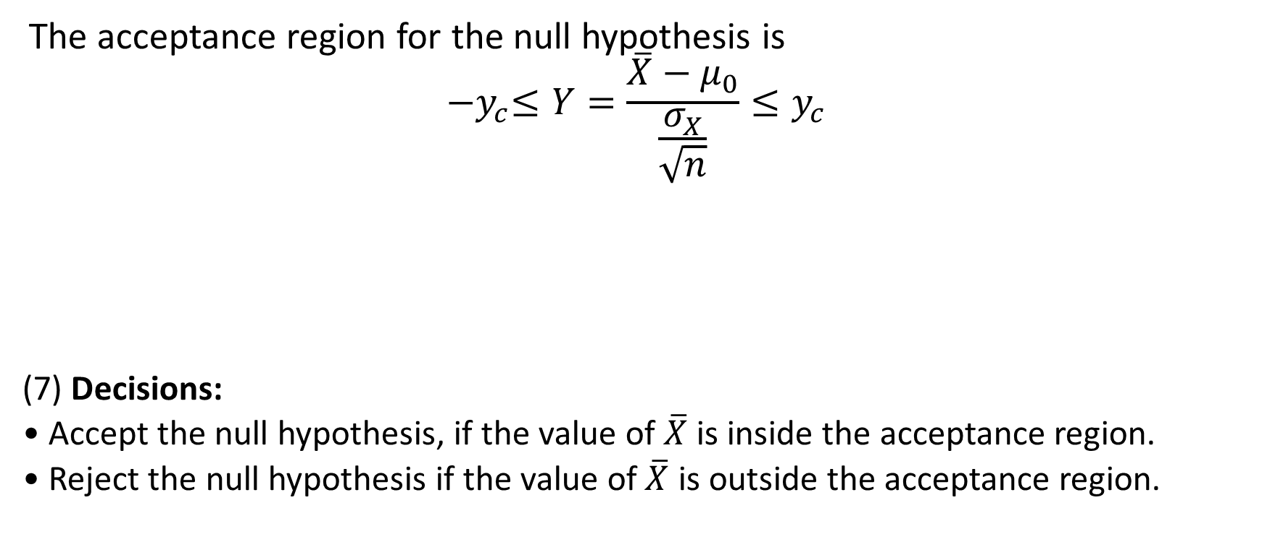
Steps for the Hypothesis Test of Population Mean (Known Population Variance)
The acceptance region for the null hypothesis is
$${−y}_{c}≤Y=\frac{\overline{X}−μ_{0}}{\frac{σ_{X}}{\sqrt{n}}}≤y_{c}$$
(7) Decisions:
• Accept the null hypothesis, if the value of $\overline{X}$ is inside the acceptance region.
• Reject the null hypothesis if the value of $\overline{X}$ is outside the acceptance region.
$${μ_{0}−\frac{σ_{X}}{\sqrt{n}}y}_{c}≤\overline{X}≤{μ_{0}+\frac{σ_{X}}{\sqrt{n}}y}_{c}$$

Slide 17
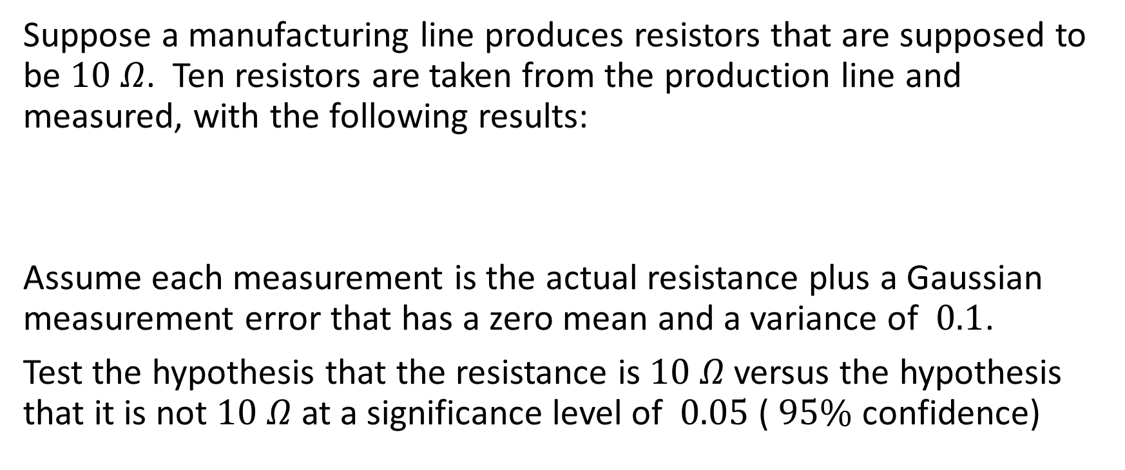
Example 1
Suppose a manufacturing line produces resistors that are supposed to be $10 Ω$. Ten resistors are taken from the production line and measured, with the following results:
Assume each measurement is the actual resistance plus a Gaussian measurement error that has a zero mean and a variance of $0.1$.
Test the hypothesis that the resistance is $10 Ω$ versus the hypothesis that it is not $10 Ω$ at a significance level of $0.05$ ( $95\%$ confidence)

Slide 18


Example 1 Solution
Hypotheses:
The test statistic:
$$Y=\frac{\overline{X}−μ_{0}}{\frac{σ_{X}}{\sqrt{n}}}. where {μ_{0}=10, σ}_{X}=\sqrt{0.1}, n=10$$
$$\overline{X}=\frac{1}{10}\sum_{i=1}^{10}{X_{i}}=9.962$$

Slide 19
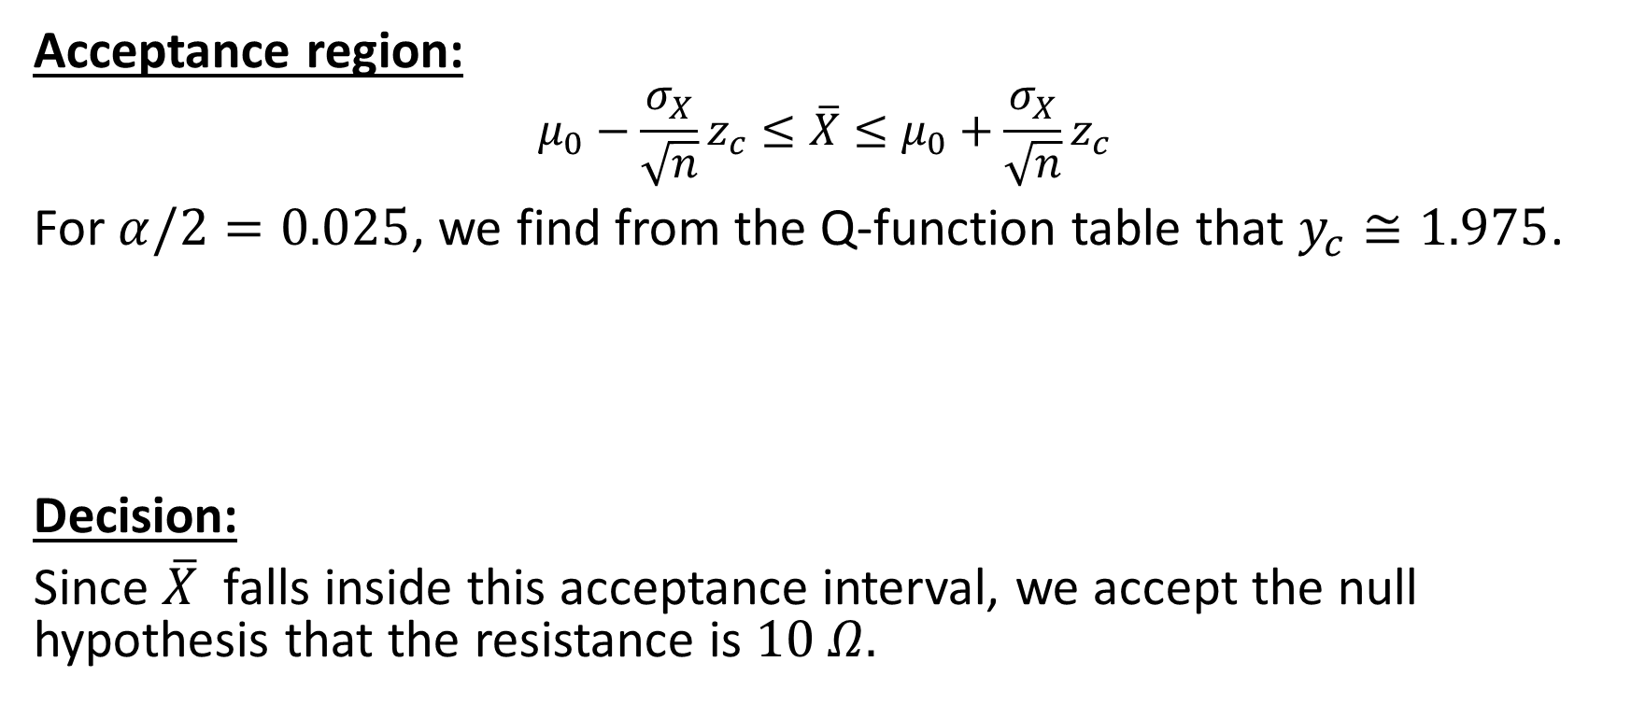
Example 1 Solution
Acceptance region:
$$μ_{0}−\frac{σ_{X}}{\sqrt{n}}z_{c}≤\overline{X}≤μ_{0}+\frac{σ_{X}}{\sqrt{n}}z_{c}$$
For $α/2=0.025$, we find from the Q-function table that $y_{c}≅1.975$.
Decision:
Since $\overline{X}$ falls inside this acceptance interval, we accept the null hypothesis that the resistance is $10 Ω.$

Slide 20
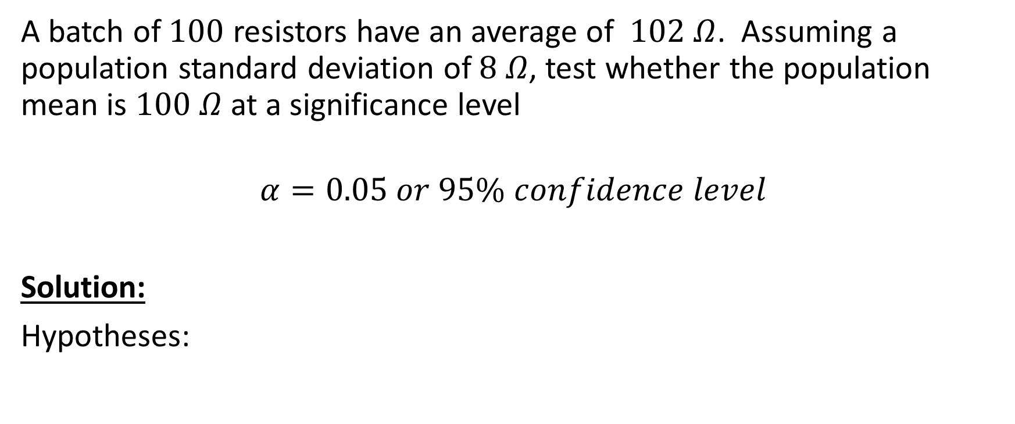
Example 2
A batch of $100$ resistors have an average of $102 Ω$. Assuming a population standard deviation of $8 Ω$, test whether the population mean is $100 Ω$ at a significance level
$$α=0.05 or 95\% confidence level$$
Solution:
Hypotheses:

Slide 21

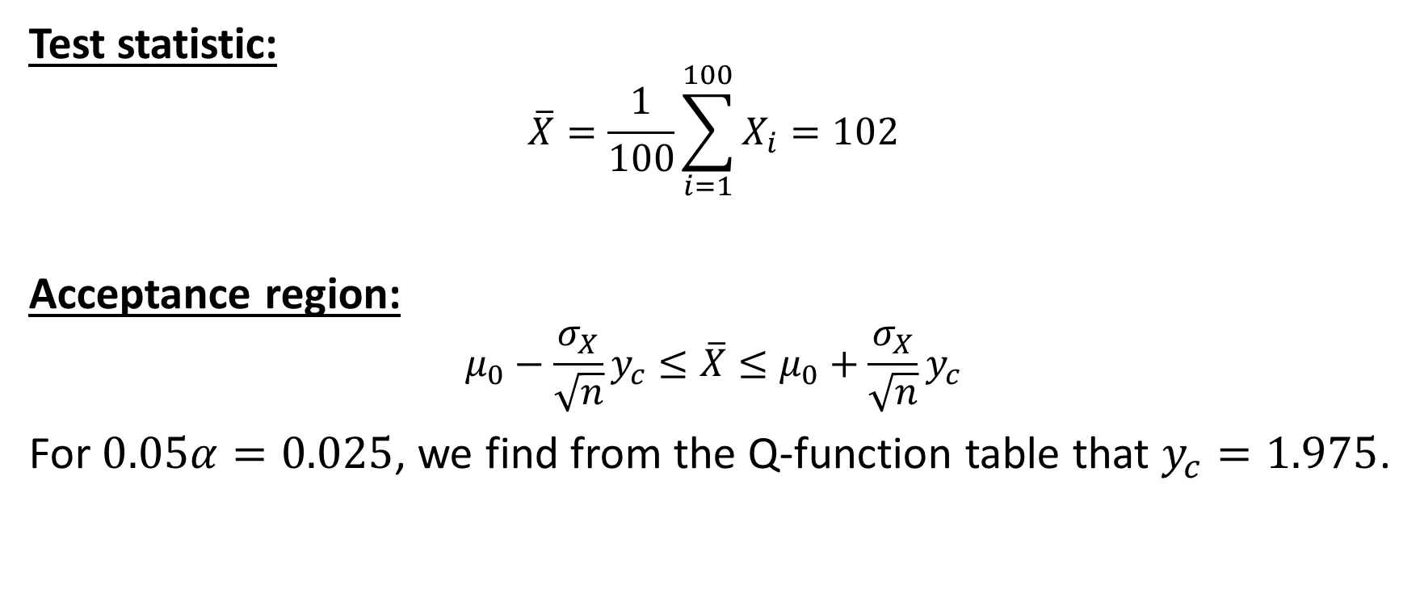
Example 2 Solution
Test statistic:
$$\overline{X}=\frac{1}{100}\sum_{i=1}^{100}{X_{i}}=102$$
Acceptance region:
$$μ_{0}−\frac{σ_{X}}{\sqrt{n}}y_{c}≤\overline{X}≤μ_{0}+\frac{σ_{X}}{\sqrt{n}}y_{c}$$
For $0.05α=0.025$, we find from the Q-function table that $y_{c}=1.975$.
$$Y=\frac{\overline{X}−μ_{0}}{σ_{X}\text{/}\sqrt{n}};$$

Slide 22
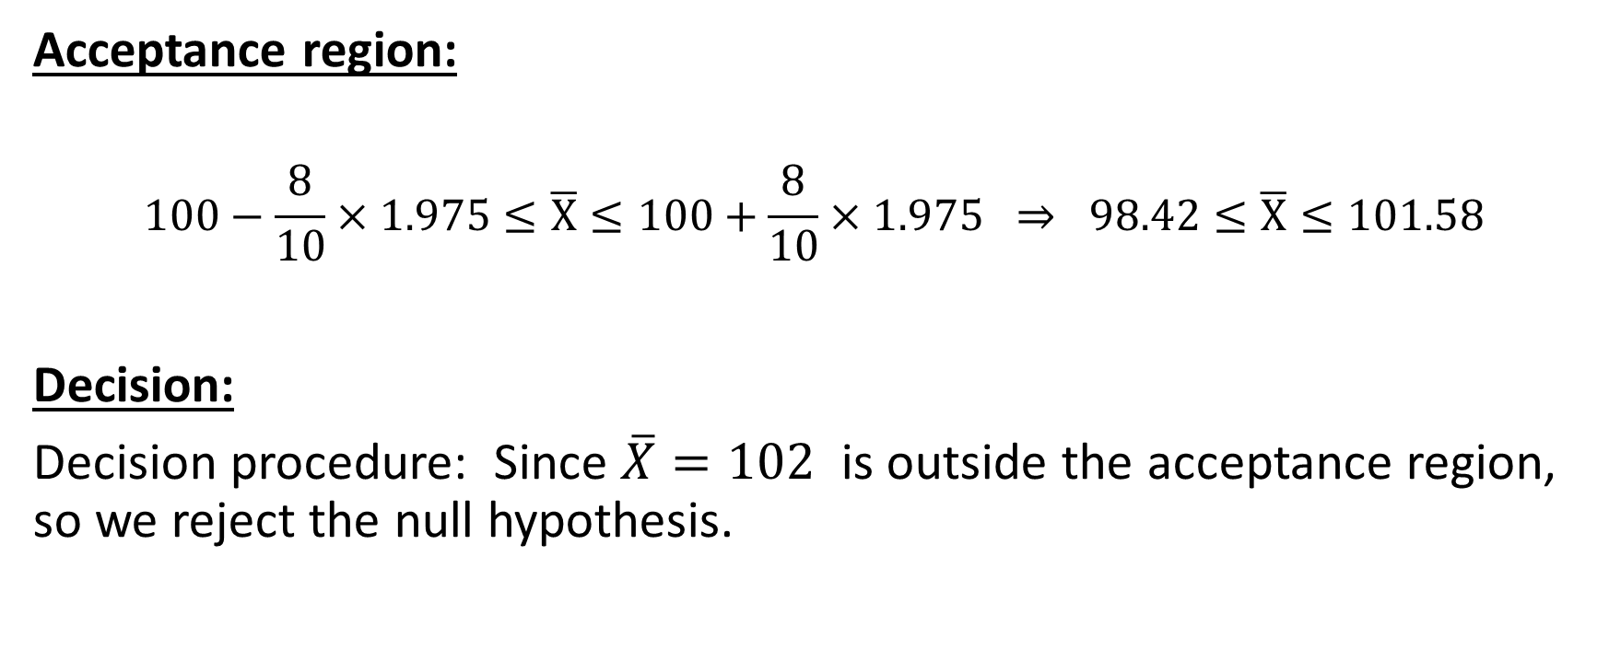
Example 2 Solution
Acceptance region:
$$100−\frac{8}{10}×1.975≤\overline{X}≤100+\frac{8}{10}×1.9\text{75} ⇒\text{ 98.42}≤\overline{X}≤101.58$$
Decision:
Decision procedure: Since $\overline{X}=102$ is outside the acceptance region, so we reject the null hypothesis.

Slide 23
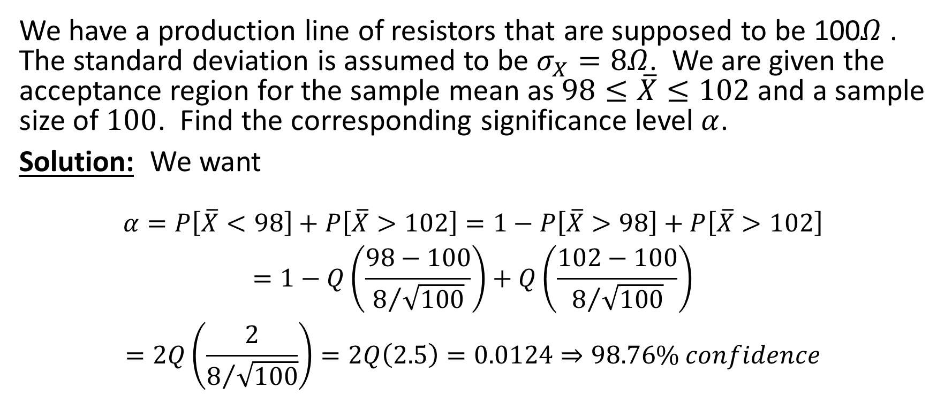
Example 3
We have a production line of resistors that are supposed to be 100𝛺 . The standard deviation is assumed to be $σ_{X}=8Ω$. We are given the acceptance region for the sample mean as $98≤\overline{X}≤102$ and a sample size of $100$. Find the corresponding significance level $α$.
Solution: We want
$$\begin{matrix}α=P\left[\overline{X}<98\right]+P\left[\overline{X}>102\right]=1−P\left[\overline{X}>98\right]+P\left[\overline{X}>102\right] \\ \begin{aligned}=1−Q\left(\frac{98−100}{8/{\sqrt{100}}}\right)+Q\left(\frac{102−100}{8/{\sqrt{100}}}\right) \\ =2Q\left(\frac{2}{8/{\sqrt{100}}}\right)=2Q\left(2.5\right)=0.0124⇒98.76\% confidence\end{aligned}\end{matrix}$$

Slide 24
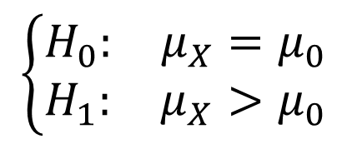

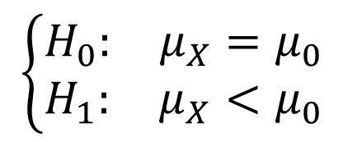
One-sided Test of Sample Mean (variance known)
Hypotheses:
Acceptance regions:
$$\left\{\begin{matrix}H_{0}: & μ_{X}=μ_{0} \\ H_{1}: & μ_{X}>μ_{0}\end{matrix}\right. ⇒ \overline{X}≤μ_{0}+\frac{σ_{X}}{\sqrt{n}}y_{c}$$
$$\left\{\begin{matrix}H_{0}: & μ_{X}=μ_{0} \\ H_{1}: & μ_{X}<μ_{0}\end{matrix}\right. ⇒\overline{X}≥μ_{0}−\frac{σ_{X}}{\sqrt{n}}y_{c}$$
For one-sided tests: $Q\left(y_{c}\right)=α$
$$\left\{\begin{matrix}H_{0}: & μ_{X}=μ_{0} \\ H_{1}: & μ_{X}>μ_{0}\end{matrix}\right.$$
$$\left\{\begin{matrix}H_{0}: & μ_{X}=μ_{0} \\ H_{1}: & μ_{X}<μ_{0}\end{matrix}\right.$$

Slide 25

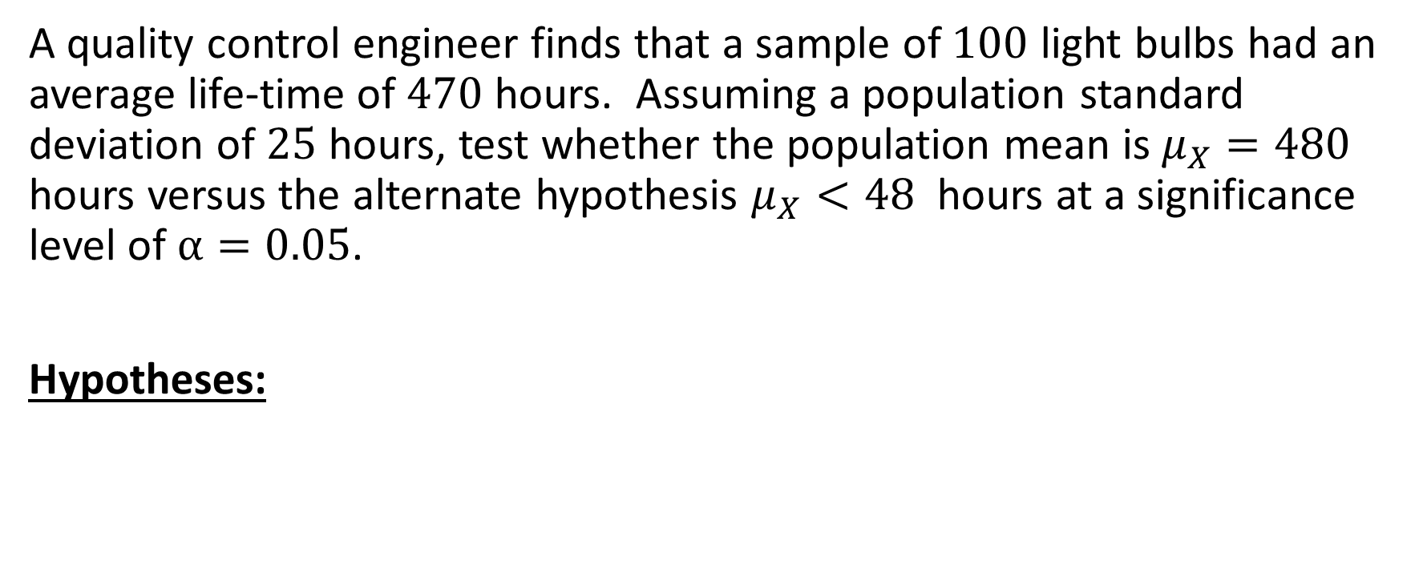
Example 4
A quality control engineer finds that a sample of $100$ light bulbs had an average life-time of $470$ hours. Assuming a population standard deviation of $25$ hours, test whether the population mean is $μ_{X}=480$ hours versus the alternate hypothesis $μ_{X}<48$ hours at a significance level of $α=0.05$.
Hypotheses:
$$\left\{\begin{matrix}H_{0}: & μ_{X}=480 \\ H_{1}: & μ_{X}<480\end{matrix}\right.$$

Slide 26

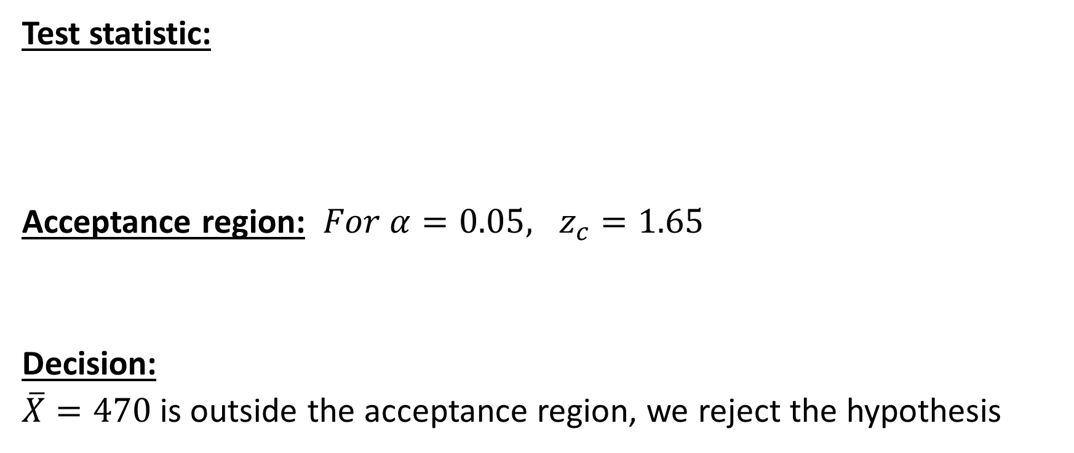
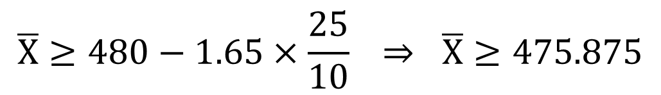
Example 4 Solution
Test statistic:
Acceptance region: ${For α=0.05, z}_{c}=1.65$
Decision:
$\overline{X}=470$is outside the acceptance region, we reject the hypothesis
$$\overline{X}=\frac{1}{100}\sum_{i=1}^{100}{X_{i}}=470$$
$$\overline{X}≥480−1.65×\frac{25}{10} ⇒ \overline{X}≥\text{4}\text{75}\text{.875}$$

Slide 27
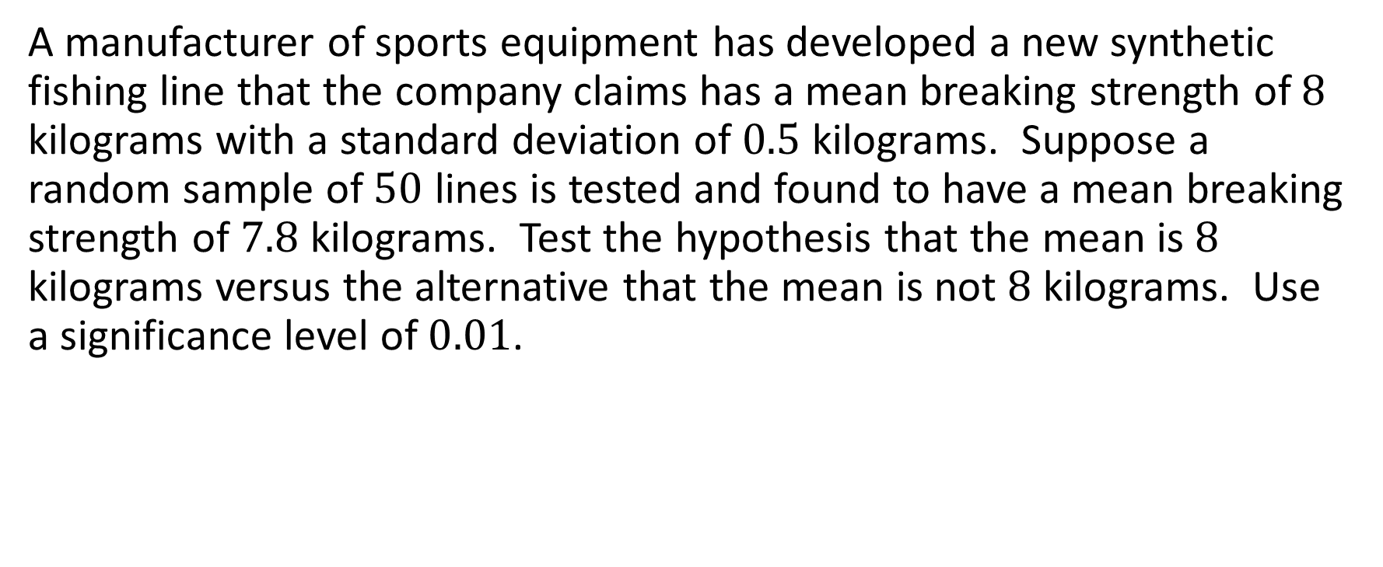
Exercise
A manufacturer of sports equipment has developed a new synthetic fishing line that the company claims has a mean breaking strength of $8$ kilograms with a standard deviation of $0.5$ kilograms. Suppose a random sample of $50$ lines is tested and found to have a mean breaking strength of $7.8$ kilograms. Test the hypothesis that the mean is $8$ kilograms versus the alternative that the mean is not $8$ kilograms. Use a significance level of $0.01$.

Slide 28
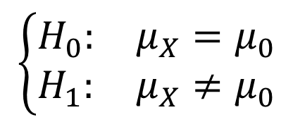


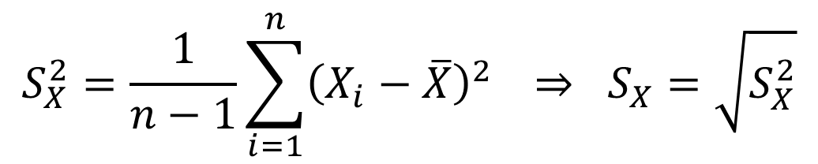
Tests Concerning Sample Mean (Variance unknown)
Hypotheses:
Test statistic: $σ_{X} is unkown, so we must estimate;$ always use unbiased estimate)
$$\left\{\begin{matrix}H_{0}: & μ_{X}=μ_{0} \\ H_{1}: & μ_{X}{≠μ}_{0}\end{matrix}\right.$$
$$S_{X}^{2}=\frac{1}{n−1}\sum_{i=1}^{n}{{\left(X_{i}−\overline{X}\right)}^{2}} ⇒ S_{X}=\sqrt{S_{X}^{2}}$$
$$T=\frac{\overline{X}−μ_{0}}{{\text{S}}_{X}\text{/}\sqrt{n}}$$

Slide 29
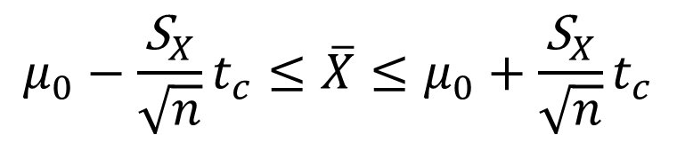
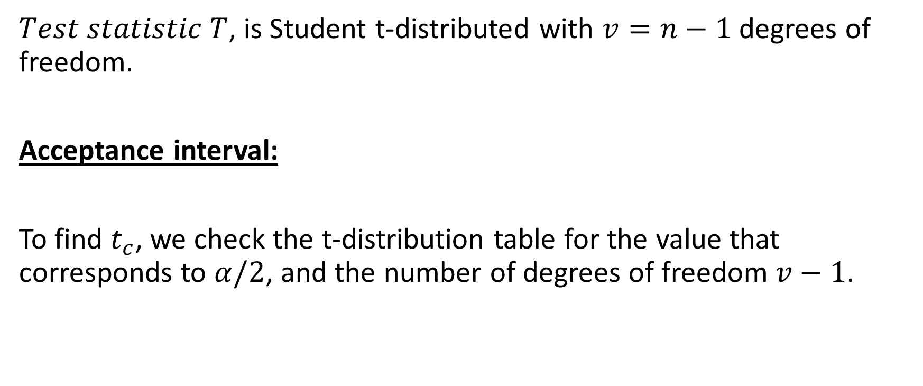
Tests Concerning Sample Mean (Variance unknown)
$Test statistic T$, is Student t-distributed with $v=n−1$ degrees of freedom.
Acceptance interval:
To find $t_{c}$, we check the t-distribution table for the value that corresponds to $α/2$, and the number of degrees of freedom $v−1$.
$$μ_{0}−\frac{{\text{S}}_{X}}{\sqrt{n}}t_{c}≤\overline{X}≤μ_{0}+\frac{{\text{S}}_{X}}{\sqrt{n}}t_{c}$$

Slide 30
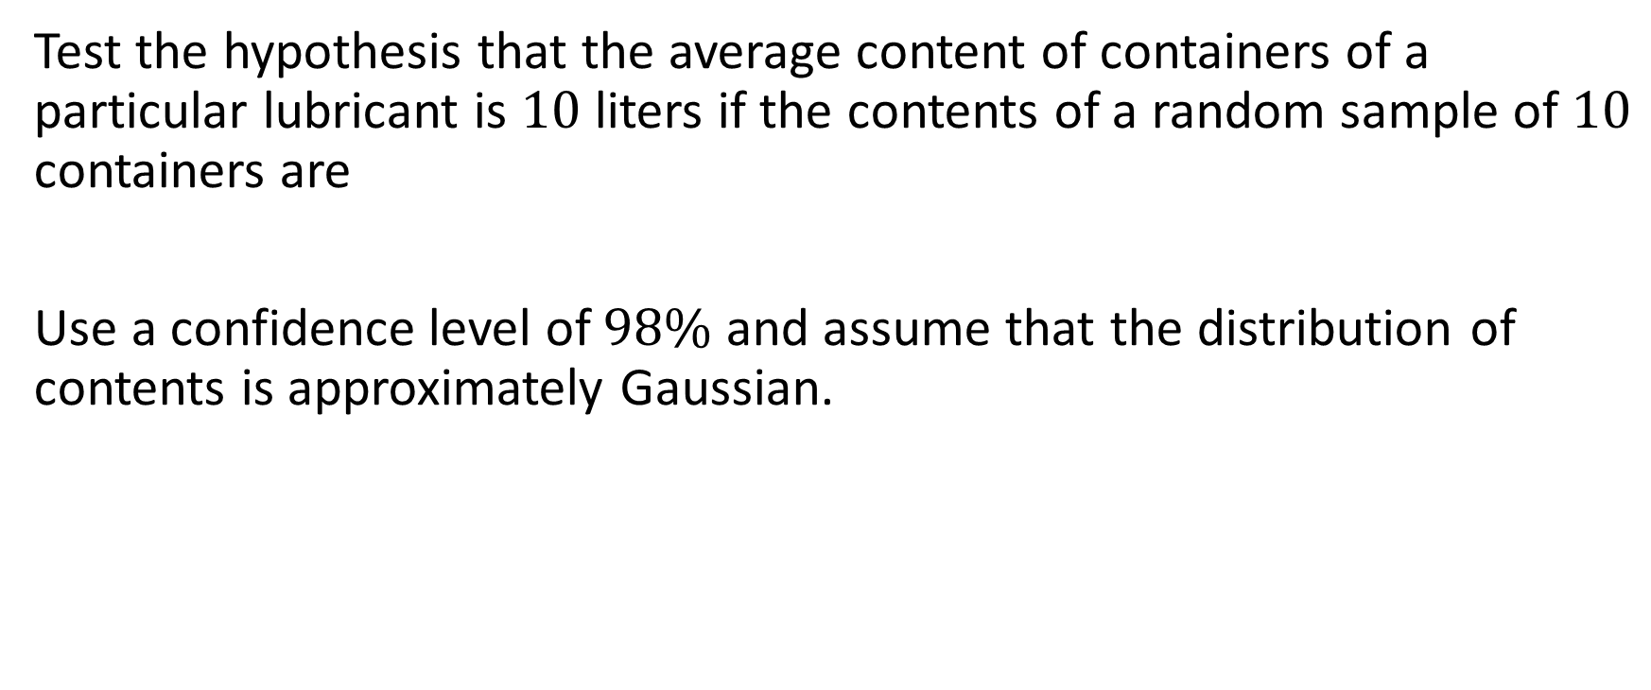
Example 5
Test the hypothesis that the average content of containers of a particular lubricant is $10$ liters if the contents of a random sample of $10$ containers are
Use a confidence level of $98\%$ and assume that the distribution of contents is approximately Gaussian.
$$10.2, 9.7, 10.1, 10.3, 10.1, 9.8, 9.9, 10.4, 10.3, 9.8$$

Slide 31


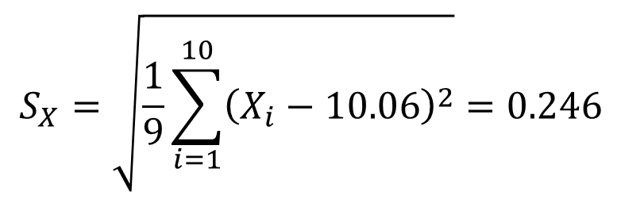

Example 5 Solution
$$for α/2=0.01 and v=9⇒t_{c}=2.821$$
Hypotheses:
Test statistic:
$$\left\{\begin{matrix}H_{0}: & μ_{X}=10, \\ H_{1}: & μ_{X}≠10.\end{matrix}\right.$$
$$S_{X}=\sqrt{\frac{1}{9}\sum_{i=1}^{10}{{\left(X_{i}−10.06\right)}^{2}}}=0.246$$
$$\overline{X}=\frac{1}{10}\sum_{i=1}^{10}{X_{i}}=10.06$$

Slide 32
Student t-Distribution Table

Slide 33
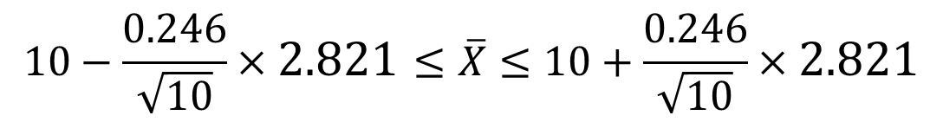


Example 5 Solution
Acceptance region:
Decision:
Since the value of $\overline{X}=10.06$ falls inside the acceptance interval, we accept the hypothesis that $μ_{X}=10 liters$.
$$10−\frac{0.246}{\sqrt{10}}×2.821≤\overline{X}≤10+\frac{0.246}{\sqrt{10}}×2.821$$
$$9.78≤\overline{X}≤10.219$$

Slide 34
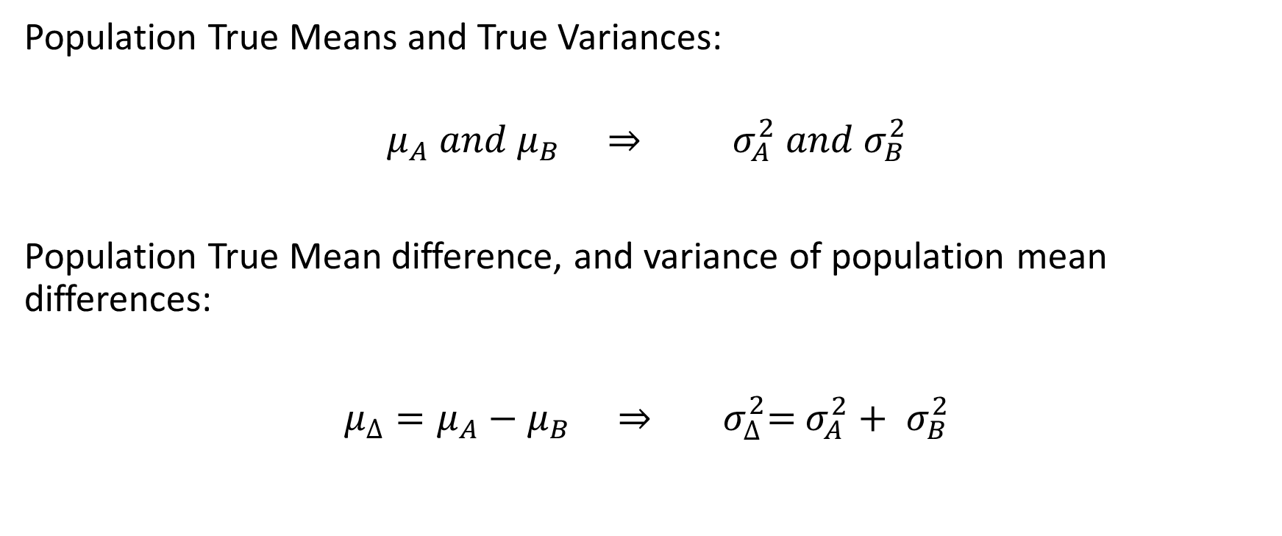
Test of Mean Difference (2 independent populations A & B)
Population True Means and True Variances:
$$μ_{A} and μ_{B} ⇒{ σ}_{A}^{2} and σ_{B}^{2}$$
Population True Mean difference, and variance of population mean differences:
$μ_{∆}=μ_{A}−μ_{B} ⇒{ σ}_{∆}^{2}=$ $σ_{A}^{2}+ σ_{B}^{2}$

Slide 35
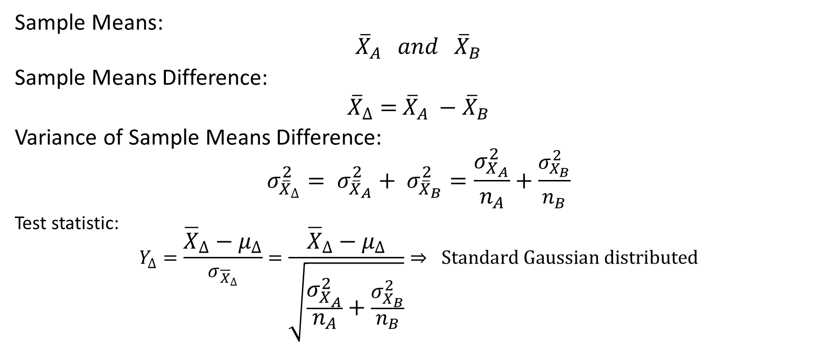
Sample Mean Difference
Sample Means:
$${\overline{X}}_{A} and {\overline{X}}_{B}$$
Sample Means Difference:
${\overline{X}}_{∆}=$ ${\overline{X}}_{A} −{\overline{X}}_{B}$
Variance of Sample Means Difference:
$$σ_{{\overline{X}}_{∆}}^{2}= σ_{{\overline{X}}_{A}}^{2}+ σ_{{\overline{X}}_{B}}^{2}=\frac{σ_{X_{A}}^{2}}{n_{A}}+\frac{σ_{X_{B}}^{2}}{n_{B}}$$
Test statistic:
$$Y_{∆}=\frac{{\overline{X}}_{∆}−μ_{∆}}{σ_{{\overline{X}}_{∆}}}=\frac{{\overline{X}}_{∆}−μ_{∆}}{\sqrt{\frac{σ_{X_{A}}^{2}}{n_{A}}+\frac{σ_{X_{B}}^{2}}{n_{B}}}}⇒ Standard Gaussian distributed$$

Slide 36
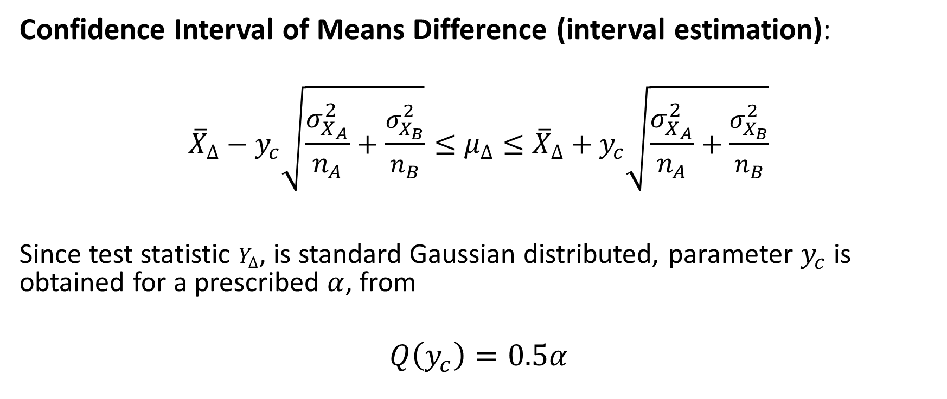
Confidence Interval of Difference of Means (Variances Known)
Confidence Interval of Means Difference (interval estimation):
$${\overline{X}}_{∆}−y_{c}\sqrt{\frac{σ_{X_{A}}^{2}}{n_{A}}+\frac{σ_{X_{B}}^{2}}{n_{B}}}≤μ_{∆}≤{\overline{X}}_{∆}+y_{c}\sqrt{\frac{σ_{X_{A}}^{2}}{n_{A}}+\frac{σ_{X_{B}}^{2}}{n_{B}}}$$
Since test statistic $Y_{∆}$, is standard Gaussian distributed, parameter $y_{c}$ is obtained for a prescribed $α$, from
$$Q\left(y_{c}\right)=0.5α$$

Slide 37
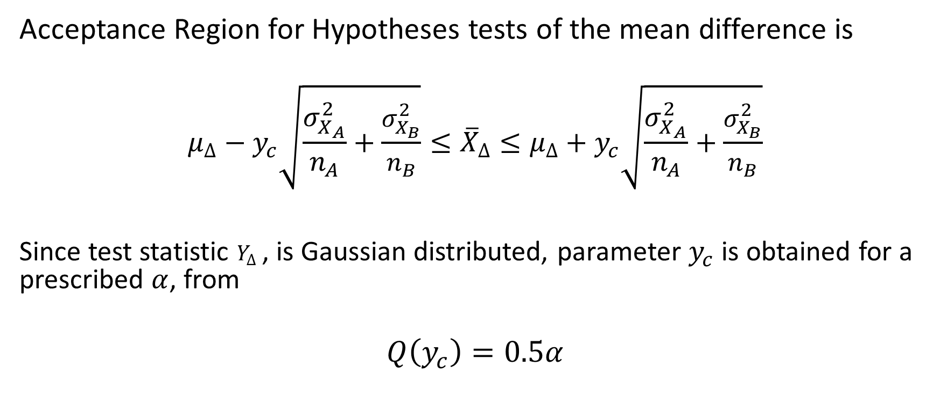
Hypotheses Tests of Difference of Means (Variances Known)
Acceptance Region for Hypotheses tests of the mean difference is
$$μ_{∆}−y_{c}\sqrt{\frac{σ_{X_{A}}^{2}}{n_{A}}+\frac{σ_{X_{B}}^{2}}{n_{B}}}≤{\overline{X}}_{∆}≤μ_{∆}+y_{c}\sqrt{\frac{σ_{X_{A}}^{2}}{n_{A}}+\frac{σ_{X_{B}}^{2}}{n_{B}}}$$
Since test statistic $Y_{∆}$, is Gaussian distributed, parameter $y_{c}$ is obtained for a prescribed $α$, from
$$Q\left(y_{c}\right)=0.5α$$

Slide 38



Confidence Interval of Difference of Means (Variances Unknown but $σ_{A}^{2}=σ_{B}^{2}$)
If $σ_{A}^{2}=σ_{B}^{2}$ we use the pooled estimator of Variance
$$T=\frac{{\overline{X}}_{∆}−∆_{0}}{S_{p}\sqrt{\frac{1}{n_{A}}+\frac{1}{n_{B}}}}=\frac{{\overline{X}}_{A}−{\overline{X}}_{B}−\left(μ_{A}−μ_{B}\right)}{S_{p}\sqrt{\frac{1}{n_{A}}+\frac{1}{n_{B}}}}$$
Test statistic $T$, has a t-distribution with ${v=n}_{A}+n_{B}−2$ degrees of freedom
$$S_{p}^{2}=\frac{\left(n_{A}−1\right)S_{A}^{2}+\left(n_{B}−1\right)S_{B}^{2}}{n_{A}+n_{B}−2}$$

Slide 39


Confidence Interval on Difference of Means (Variances Unknown but $σ_{A}^{2}=σ_{B}^{2}$)
Confidence Interval of mean difference:
$${\overline{X}}_{∆}−t_{c}S_{p}\sqrt{\frac{1}{n_{A}}+\frac{1}{n_{B}}}≤μ_{∆}≤{\overline{X}}_{∆}+t_{c}S_{p}\sqrt{\frac{1}{n_{A}}+\frac{1}{n_{B}}}$$
Since test statistic $Y_{∆}$, is t-distributed, parameter $t_{c}$ is obtained for a prescribed $α$, from the t-distribution table.

Slide 40


Hypotheses Tests on Difference of Means (Variances Unknown but $σ_{A}^{2}=σ_{B}^{2}$)
Hypotheses:
$$\left\{\begin{aligned}H_{0}:μ_{∆}=μ_{A}−μ_{B}=∆_{0} \\ &H_{1}:μ_{∆}=μ_{A}−μ_{B}≠∆_{0}\end{aligned}\right.$$
For $σ_{A}^{2}=σ_{B}^{2} ,$ use pooled estimator of variance of mean difference:
$$S_{p}^{2}=\frac{\left(n_{A}−1\right)S_{A}^{2}+\left(n_{B}−1\right)S_{B}^{2}}{n_{A}+n_{B}−2}$$

Slide 41


Hypotheses Tests on Difference of Means (Variances Unknown but $σ_{A}^{2}=σ_{B}^{2}$)
Test Statistic for $σ_{A}^{2}=σ_{B}^{2}$
$$T=\frac{{\overline{X}}_{A}−{\overline{X}}_{B}−\left(μ_{A}−μ_{B}\right)}{S_{p}\sqrt{\frac{1}{n_{A}}+\frac{1}{n_{B}}}}$$
Has t-distribution with ${v=n}_{A}+n_{B}−2$ degrees of freedom
Acceptance region:
$$∆_{0}−t_{c}S_{p}\sqrt{\frac{1}{n_{A}}+\frac{1}{n_{B}}}≤{\overline{X}}_{∆}≤∆_{0}+t_{c}S_{p}\sqrt{\frac{1}{n_{A}}+\frac{1}{n_{B}}}$$

Slide 42


Hypotheses Tests on Difference of Means (Variances Unknown but $σ_{A}^{2}≠σ_{B}^{2}$)
Test Statistic for $σ_{A}^{2}≠σ_{B}^{2}$
$$T=\frac{{\overline{X}}_{A}−{\overline{X}}_{B}−\left(μ_{A}−μ_{B}\right)}{\sqrt{\frac{S_{A}^{2}}{n_{A}}+\frac{S_{B}^{2}}{n_{B}}}}$$
Test Statistic $T$ has degrees of freedom calculated as
$$v=\frac{{\left(\frac{S_{A}^{2}}{n_{A}}+\frac{S_{B}^{2}}{n_{B}}\right)}^{2}}{\frac{{\left(\frac{S_{A}^{2}}{n_{A}}\right)}^{2}}{n_{A}−1}+\frac{{\left(\frac{S_{B}^{2}}{n_{B}}\right)}^{2}}{n_{B}−1}}, rounded up to an integer$$

Slide 43

Hypotheses Tests on Difference of Means (Variances Unknown but $σ_{A}^{2}≠σ_{B}^{2}$)
Acceptance region:
$$∆_{0}−t_{c}\sqrt{\frac{S_{A}^{2}}{n_{A}}+\frac{S_{B}^{2}}{n_{B}}}≤{\overline{X}}_{∆}≤∆_{0}+t_{c}\sqrt{\frac{S_{A}^{2}}{n_{A}}+\frac{S_{B}^{2}}{n_{B}}}$$

